Slide 1
CONTROL OF EXAMS
Under Supervision of:-
Dr. Hatem El Boghdady
Made By:-
1.Tarek mohamed mohamed diab
2.Taha sayed ahmed
3.Ahmed khalaf
4.Mustafa hassan
5.AbdElrady elagmy

Slide 2
Contents:-
System request 3
Project abstraction 4
Expected value 5
Special issues or constraints 6
Feasibility analysis 7
Technical feasibility 8
Economic feasibility 9
Work plan 11
Interviews report 13
Analysis plan 14
Analysis plan table 15
Logical data model 16

Slide 3
System Request
Project Name: Control of Exams Room
Project Sponsor: Dr/ Magdy m. Dos
Department: Management
E-mail: magdy@aun.eun.eg
Business Need: To Facilitate controlling of
grades
Functionality:
-Store grades of students in a database
-To calculate All grades of Student in exams
-Control of help grades for those who are less than success grades
-Search through project database for specific student
-Order students according to their total grades
-Retrieve or print any result in system database

Slide 4
Project abstraction:-_x000b_
        The project offer a service of the control exam , project save the students data in database by administrators then enter the grades of students in all study year, then by rules saved in database the result can take from the project and then introduced the result to student
        From the project the faculty can save more time and money and student can know the result with faster way

Slide 5
Expected Value
Tangible:
1. avoid using mountain of papers that used in . 2. previous system reduce 30% of number of employee .
Intangible:
1. improved customer satisfaction .
2. reduced time consumption .
3. reduce possibility of error occurrence .

Slide 6
Special issues or constraints:
1. project must be delivered within two months .
2. low budget for our system .
3. users may be not familiar with system or project .
4. users need two weeks at training .
5. program shouldn't cause any economic or physical damage in the event of system failure .

Slide 7
Feasibility Analysis
Technical Feasibility (moderate):
Familiarity with Application (moderate):
users have some experience with computer knowledge
the information system department has very good experience with application area
Familiarity with technology (moderate):
Development tools & product of management application are available in market place & we have a good experience with them
*We are aware of database management system(DBMS) & ADO. Net Technology due to using it before
*The system will run off of users' inventory database system, which is robust & stable

Slide 8
Technical Feasibility cont
Project size (moderate):
We estimate that the project is moderate in size & we will build the system from scratch With some effort, we can design the system to be reliable & to be more efficiency thanks to new technology we use

Slide 9
Economic feasibility (excellent):
Tangible cost & benefit:
avoid using mountain of papers that used in previous system
reduce 30% of number of employee
reduce tools cost
Intangible cost & benefit:
improved customer satisfaction
reduced time consumption
reduce possibility of error occurrence
Organizational feasibility (excellent):
Project champion: Dr/Magdy m. Doss
Senior Management: There is very strong of the project within the senior management team

Slide 10
Users:
1.Affairs department
2.Control system staff
3.End users of employees
Other Stakeholder:
1.University president
2.Our faculty's doctors
3.Hardware & software engineering

Slide 11
Work plan | Deliverables | Estimated Hours | Actual Hours | Assigned to
Planning
Project Initiation
Identify Business Value | System Request | 4 |  | Sponsor
Feasibility Analysis | Feasibility Analysis | 5 |  | Sponsor
Perform Technical Feasibility |  | 8 |  | Sponsor
Perform Economic Feasibility | Cost-Benefit Analysis | 8 |  | Sponsor
Perform Organizational Feasibility | Stakeholder Analysis | 5 |  | Sponsor
Project Management
Create Work Plan | Work Plan | 8 |  | Project Mgr
Staff The Project | Staffing Plan | 5 |  | Project Mgr
Control & Direct the project |  |  |  | Project Mgr

Slide 12
Set Up Case Tool |  | 4 |  | Project Mgr
Prepare Documentation |  | 2 |  | Project Mgr
Determine Standards | Standard list | 2 |  | Project Mgr
Analysis | Logical data, process model Physical data, process model | 68
Design |  | 119
Implementation |  | 102

Slide 13
Interviews Report:-
_The first interview was made with Mr.magdy The Manager of exam control to take general overview about the project
_The second interview made it with Mr.Moustafa the manager of student affairs to current problem with how to deal with the subjects grades
_The third interview made with Mr.Ali Employee in the student affairs Know the roles of add the help grades &to
Know how to deal with the illness sorrows and previous failed subjects
_We have met with Dr.Magdy again to know the way of showing final results and ensure from the collected data

Slide 14
Analysis Plan :-
We use business process automation
1- Understand the As-Is System:-
*Interviews
2- Identifying Improvements:-
*we use problem analysis
3- Developing a To-Be system concept

Slide 15
Analysis Plan
Step | Who and How
Understanding the as-is system Review documentation Informal benchmarking | Analysts will review the process and data models for the storing grades, adding help grades, accepting illness sorrows and showing final results. Analysts will review an exciting system.

Slide 16
Identifying improvements Problem analysis Technical analysis Outcome analysis | Analysts will work with controlling exam staff who identify a basic set features of the system Analysts will develop a list of innovative controlling technologies. Analyst and controlling staff will work together to develop possible application. Analysts will work with controlling staff to discuss why they need the system.
Developing a to-be system concept Develop process model Develop data model | Analysts will develop a process model for to-be system. Analysts will develop a data model for to-be system

Slide 17
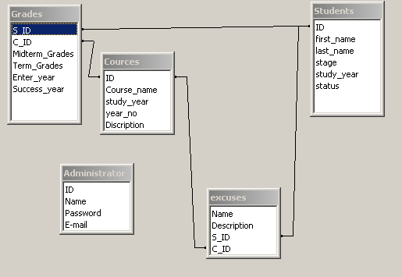
Logical data model

Slide 18
Thanks for every one help us

